Slide 1
Ciphers and Hashes

Slide 2
Housekeeping
Jason Damaron’s Pentesting coversation: tomorrow @ 5:30
Workshop_02 Networking Basics & Wireshark 10/9 @ 5:00
Jason Trinklein’s Network Talk: 10/10 @ 5:30
CTF Project update????

Slide 3
Ciphers

Slide 4
What are Ciphers and how do they work?
Cipher- a method to transform text to hide its meaning (Merriam-Webster def. 2)
Types of ciphers (there are a lot but here are some common ones):
Caesar
Vigenere
Decimal
Base64
Binary
Hex
Baconian
And more!

Slide 5
How to decode ciphers

Slide 6
The 2 ways:
Scripting
Python, BASH, etc.
Through the Web:
Rapidtables: https://bit.ly/2nqHKBM
Rumkin: https://bit.ly/1tgtYh0
Examples (see crypto.zip, cipherSignatures)

Slide 7
Practice!
cipherChallenge.txt

Slide 8
Hashing and Cracking Passwords

Slide 9
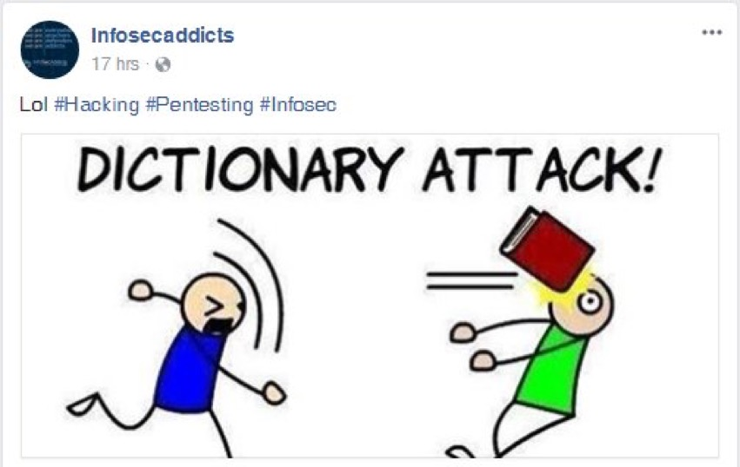

Slide 10
What is hashing?
Short Answer: a more secure cipher
Long Answer: It’s a way to remap the values of a string for secure transmission and file integrity (think of computer forensics)
Example Hashes: see the crypto.zip file “hashSignatures.txt”
How to use file integrity:
md5sum <file>
sha[1, 256, 384, 512]sum <file>
Example - ParrotOS md5 checksum
Parrot Security 4.7 x64 (iso) - 97b80f3f05cb48aab61c59586e11a49a
How to Calculate Hashes: https://bit.ly/2IwTZJ8
Notes:
Full Definition: https://www.techopedia.com/definition/14316/hashing

Slide 11
How to Identify a Hash
via CLI:
hash-identifier <single hash>
via Web:
https://bit.ly/2p9t9zf
PUT HASHES OF THE SAME TYPE IN A .TXT FILE TO CRACK AT ONE TIME

Slide 12
Now that you have the hash, now what?

Slide 13
How to Crack a Hash
Step 1: Dictionary
RockYou.txt: /usr/share/wordlists
Note: you need to use gunzip rockyou.txt.gz and then cp rockyou.txt to a directory that is easy to access to you
Create your own:
Crunch (no mask): crunch <min> <max> [charset] >> output.txt
Crunch (w/ mask): crunch <min> <max> -t String-txt-@,%^ >> output.txt
@= lowercase letters
. (comma)= uppercase letters
%= numbers
^= symbols
Cewl: cewl -d 0 <url> >> output.txt
SecLists: git clone https://github.com/danielmiessler/SecLists.git

Slide 14
Password Cracking Tools
Step 2: Crack w/ CLI (Hashcat)
Straight Attack: sudo hashcat: hashcat -a <attack type> -m <hash num> hashes.txt ~/path/to/dictionary (or dictionary file if working within the same directory) --show >> cracked.txt
Note from experience: run hashcat once before using the --show in order to crack hashes and outputting cracked hash
Combination: sudo hashcat: hashcat -a <attack type> -m <hash num> hashes.txt /path/to/dictionary1 /path/to/dictionary2 (or dictionary file if working within the same directory) --show >> cracked.txt

Slide 15
Password Cracking Tools cont.
via CLI
John the Ripper (john --list=formats)
Password file: sudo --format=<hashtype> john hashes.txt
MD5 = raw-md5
Zip: zip2john <file>.zip >> johnhash.txt

Slide 16
Password Cracking cont.
NTLM via GUI
Applications → Pentesting → Password Attacks → Local attacks → Ophcrack
Need to download ophcrack tables: https://bit.ly/2mG7mhs
Just as an FYI, these tables can take up a lot of storage
To load in tables: Tables → Select Table → Find where its installed → Select & hit Ok
Note: you will have to do this every time you use ophcrack

Slide 17
Practice!
hashChallenge.txt

